Slide 1
Week 6: Workshop – methodology assignment
INFT 4017

Slide 2
Methodology assignment in this course
As you are writing a literature survey paper (research paper assignment) that reviews existing work, you need to analyse the papers of your readings to determine:
common elements,
how well they perform at what they claim to do
strengths/advantages or weaknesses/disadvantages
how they compare to each other
Identification of research gaps
Form research questions based on the gaps identified

Slide 3
Methodology will be for your team's Research paper.
Selected methodology – based on the team’s discussions

Slide 4
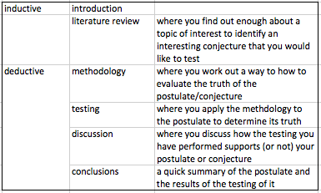
The Research Paper reflects two main approaches to doing research, inductive and deductive.

Slide 5
Within your team’s theme, each person will now suggest a specific sub-theme, or postulate.
Your postulate will be something you have observed in your readings on the topic so far.

Slide 6
To start your methodology, you need to outline your postulate as a nested set of formal research questions.
These questions should address all the relevant points.

Slide 7
Outline questions you are going to ask when you assess each reading (questions are asked based on the your AB readings and beyond).
Example:
questions on whether privacy is mentioned in the reading,
if so whether it is given importance,
whether privacy is potentially compromised by the methods or ideas in the reading

Slide 8
Example

Slide 9
For group projects, each group member needs to propose a set of questions around his/her topic (i.e. an individual methodology).
The group will meet during the week 8 to discuss the methodologies identified.
The group will decide to either go with one of those methodologies or instead to distill a final methodology from the individual ones.
The decision (i.e. the selected methodology) made by the group should be justified and documented.

Slide 10
Submission format
The submission file should start with a cover page.
For group projects, all members of the group should collate their methodology proposals into a single file. A table of contents is also needed.

Slide 11
Submission format (cont.)
For group projects, the selected methodology proposal should appear first.
If the selected methodology was condensed from any or all of the individual proposals, the contributions from each individual proposal should be described in a separate page appearing immediately before the selected methodology.

Slide 12
Submission format (cont.)
For group projects, in the collated file, individual methodology(ies) should follow the selected methodology and be presented by individual students.
A single .doc/.docx file should be submitted by one member of the group only.

Slide 13
Methodology feedback form is available on the course website in the Assignments section.
Please review the feedback form and the specifications of this assignment on the course website.
If you have any questions regarding this assignment, please post your query to the corresponding assignment forum which Tina will monitor and answer your questions.

